Slide 1
VERIFICATION WITH USERS
MEASUREMENT AND PROCESS CONTROL SYSTEMS
DIYmeteo – Meteorological station made out of waste material
Leonarda Gajdić, Tomislav Krvavica, Johannes Pelz, Tom Schwarting, Kristijan Vešligaj

Slide 2
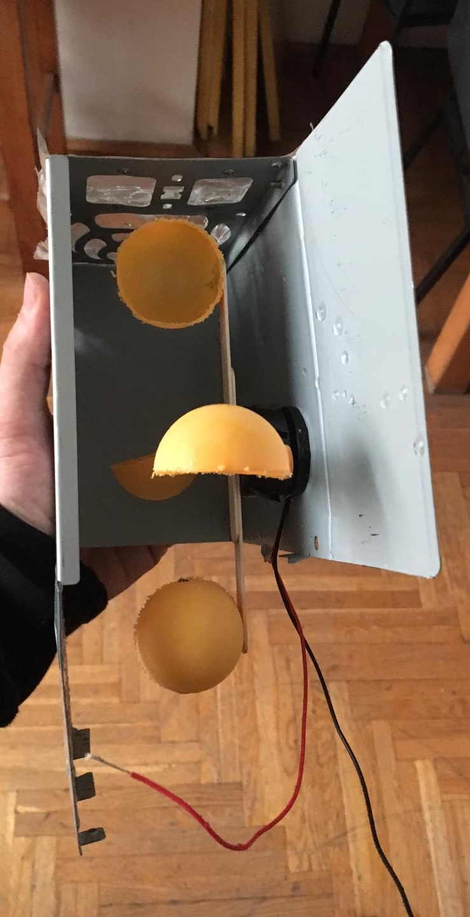
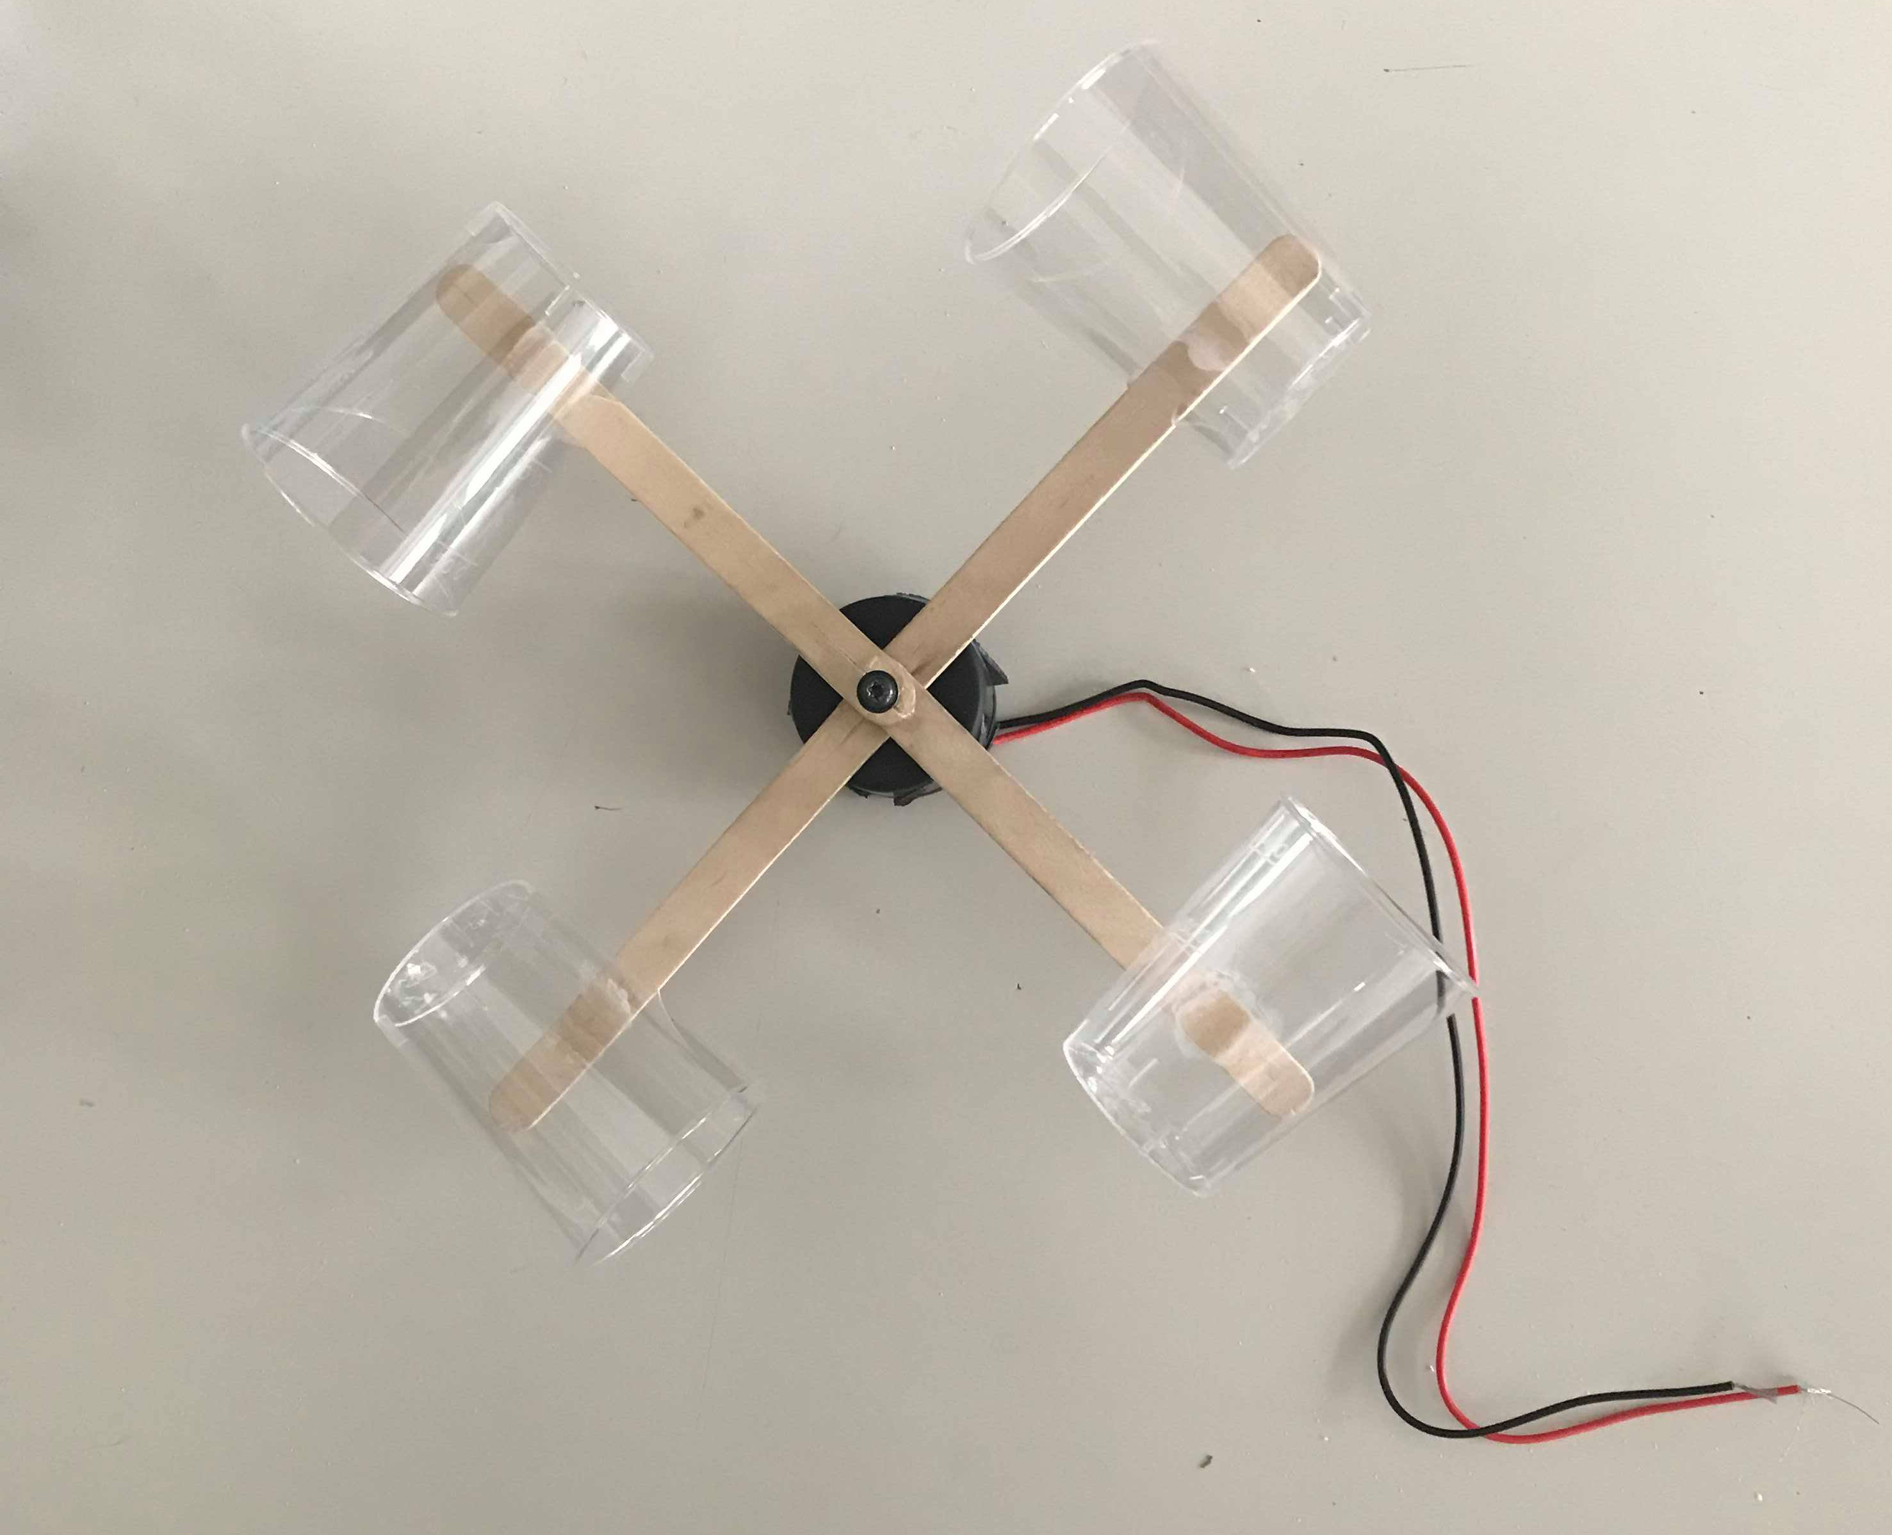
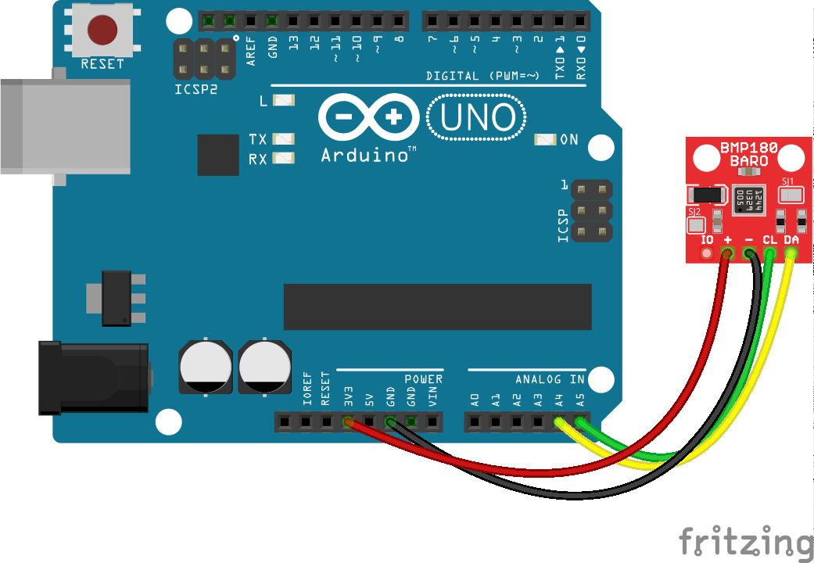
PLAN OF THE VERIFICATION MEETING
Demonstration of finished sensors

Slide 3
PLAN OF THE VERIFICATION MEETING
Demonstration of the design of sensors that are not finished yet

Slide 4
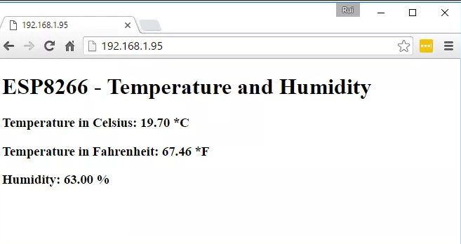
PLAN OF THE VERIFICATION MEETING
Demonstration of web server for result presentation

Slide 5
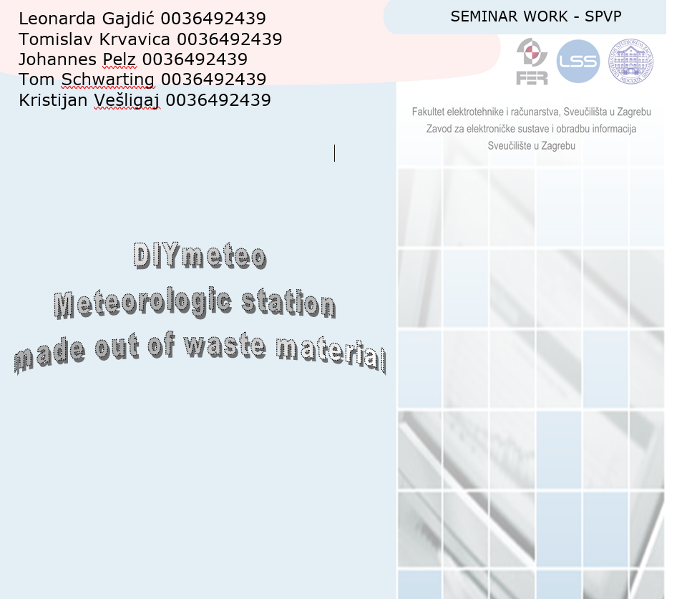
PLAN OF THE VERIFICATION MEETING
Agreement on final documentation editing

