Slide 1
RESEARCH PHASE EXISTING SOLUTIONS
MEASUREMENT AND PROCESS CONTROL SYSTEMS
DIYmeteo – Meteorological station made out of waste material
Leonarda Gajdić, Tomislav Krvavica, Johannes Pelz, Tom Schwarting, Kristijan Vešligaj

Slide 2
INTRODUCTION
This presentation will cover every sensor that will be used
It will be written about the use of every of the sensors and where can they be found in electronic waste

Slide 3
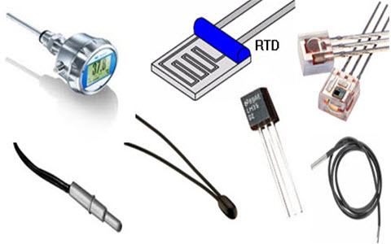
TEMPERATURE SENSOR
A temperature sensor is a device that detects and measures hotness and coolness and converts it into an electrical signal
Types of temperature sensors
Thermocouple
The RTD
Thermistors
Semiconductor sensor
Digital Temperature Sensor
We can found them in personal computers and mobile phones

Slide 4
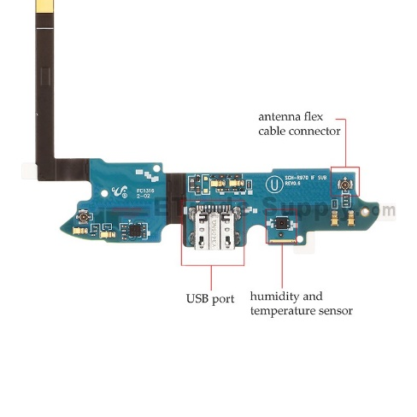
TEMPERATURE SENSOR
Smartphones with air temperature sensor
Samsung Galaxy S4
Samsung Galaxy Note 3
Motorola Moto X
Motorola Moto X Second Generation
Samsung Galaxy was one of the first smartphones that featured temperature sensor for reading the environmental temperature. It features a handful of other sensors like accelerometer, gyro, proximity, compass, barometer, humidity, and gesture.

Slide 5
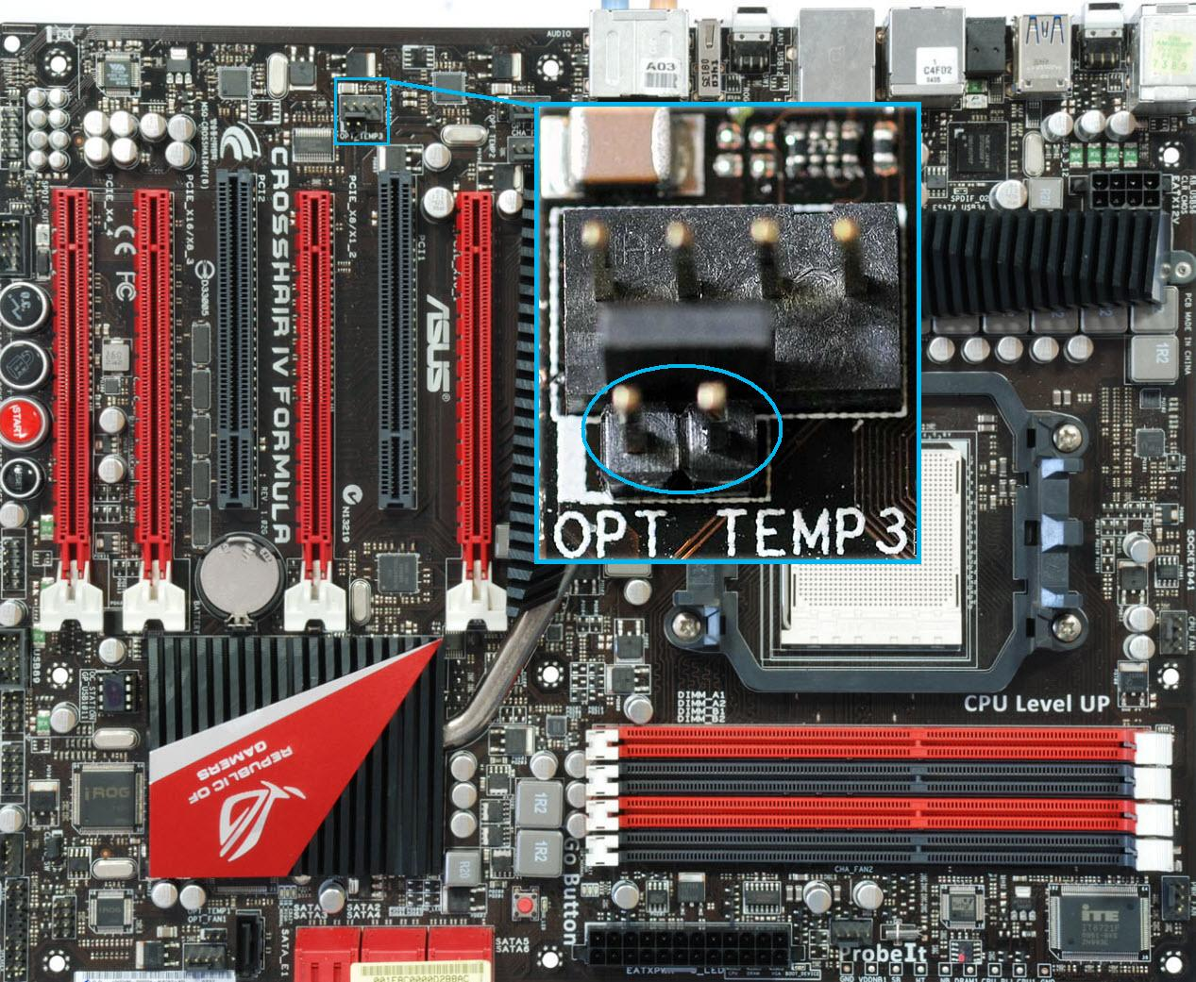
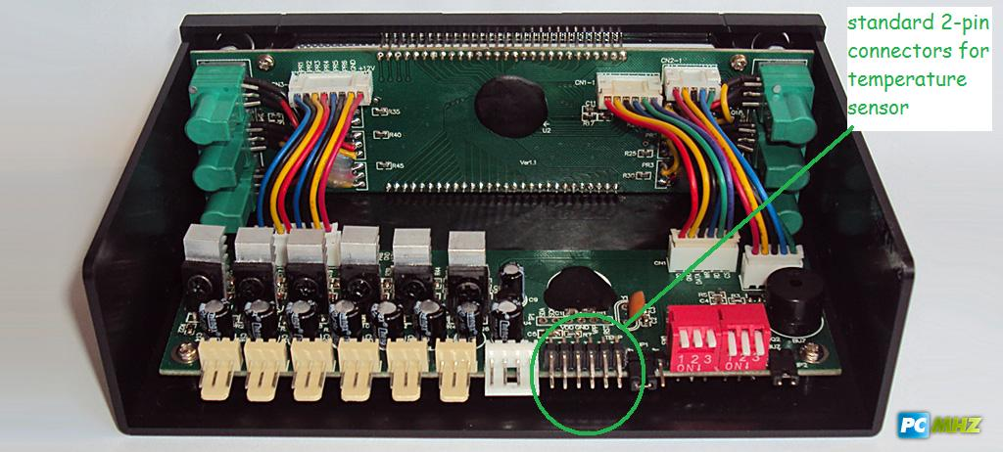
TEMPERATURE SENSOR
Modern laptops have lots of temperature sensors built-in
Temperature sensors are mostly located on motherboard

Slide 6
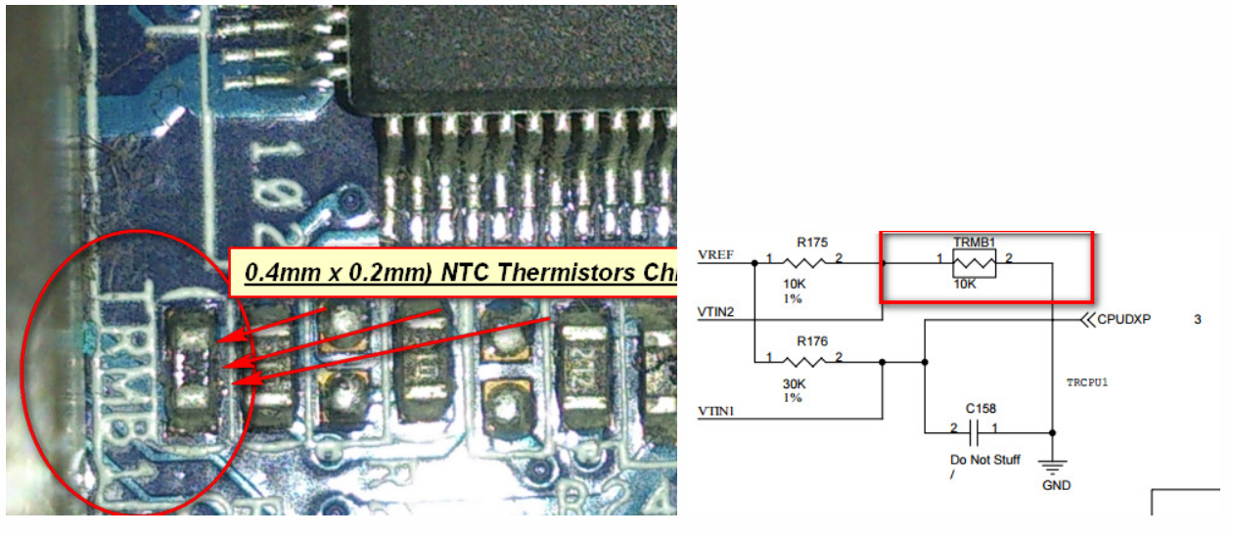
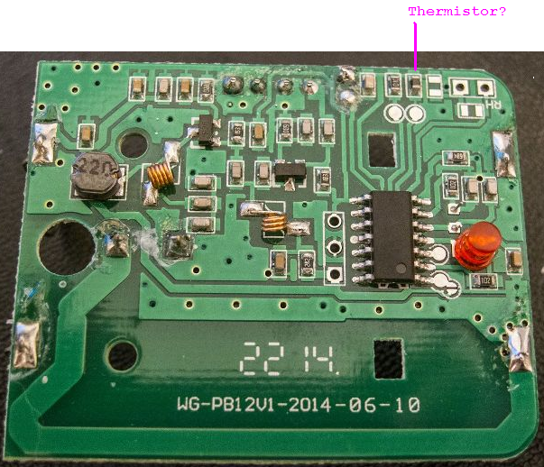
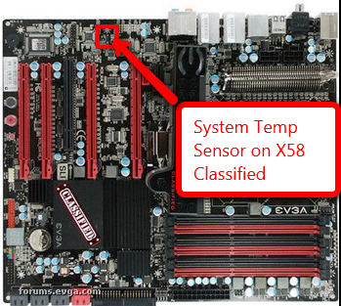

Slide 7
AIR PRESSURE
It’s impossible to make this type of sensor based on purely electronic components
It’s possible to make this using jar, balloon, straw, needle and some sort of paper scale
Digitalization could be done via capacitive sensor, if we use sensor as scale

Slide 8
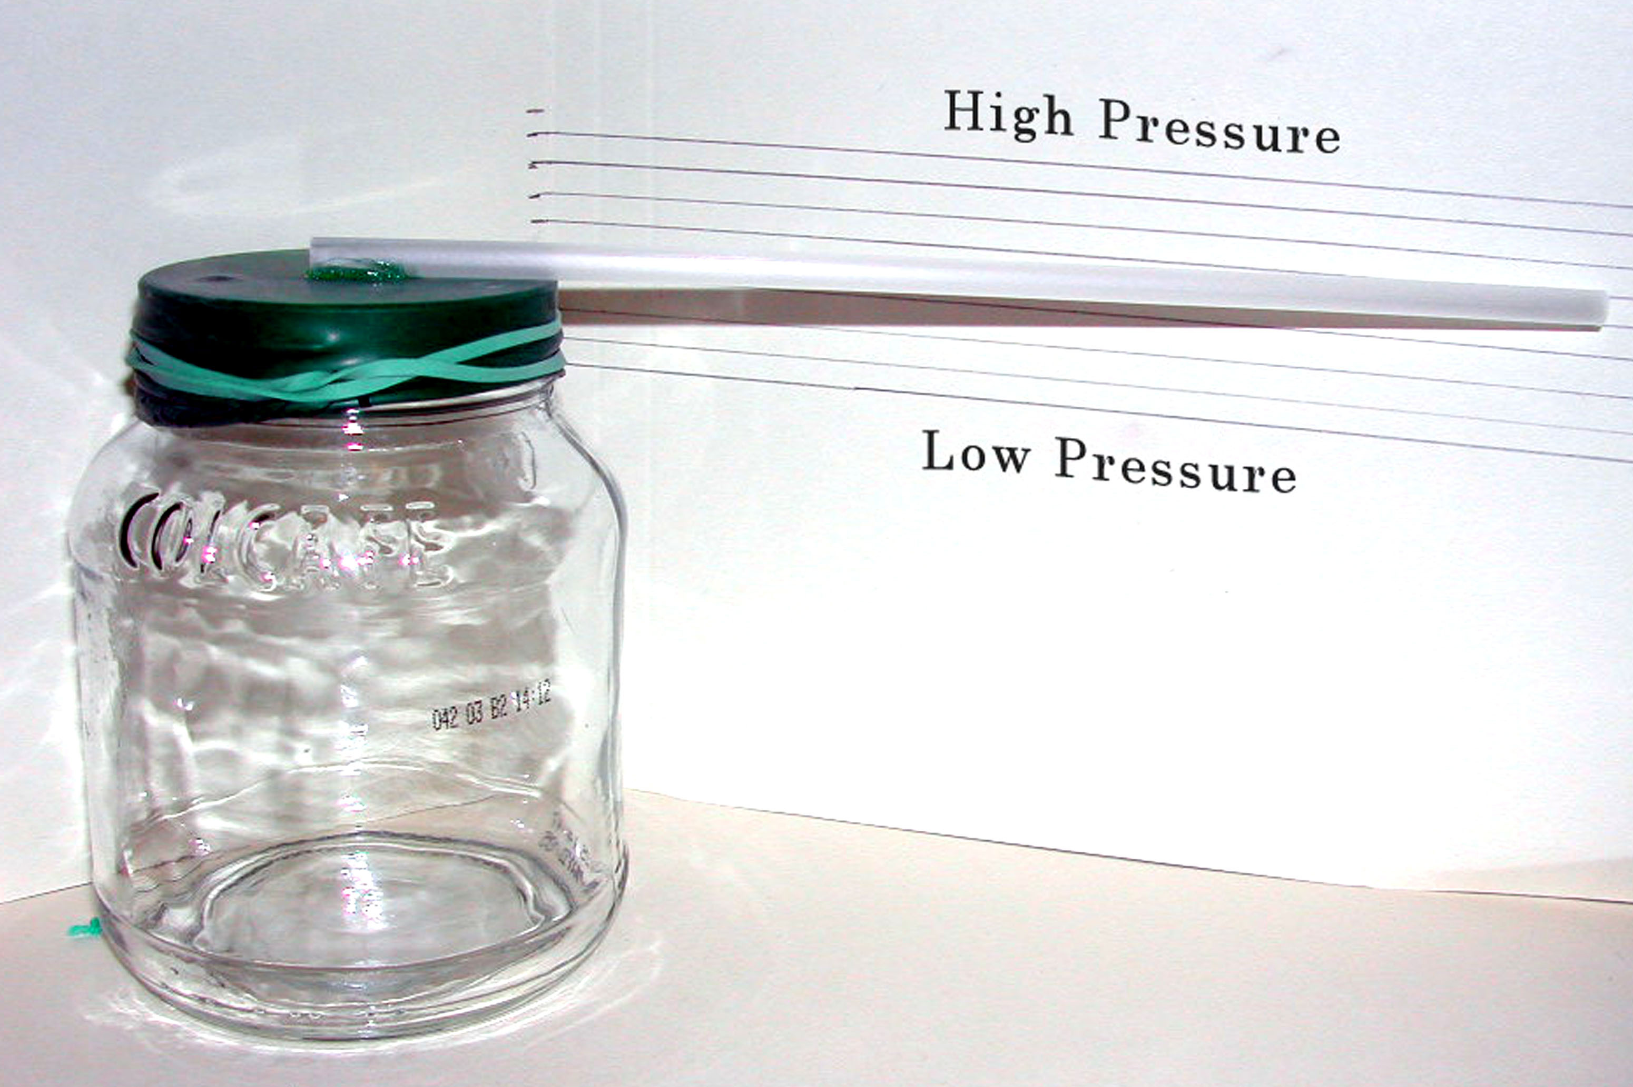
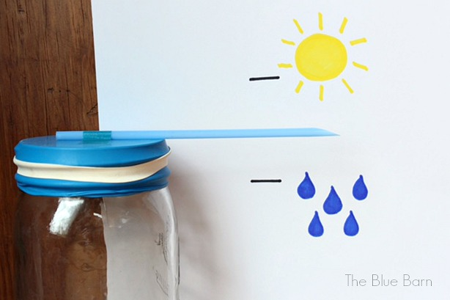

Slide 9
ANEMOMETER
Anemometer could be implemented if there could be found a DC motor inside the old PC
There should be a DC motor inside CD tray, cooler and inside of a hard disk
Blades for catching wind could be made from all sorts of used stuff - for example, there can be found used plastic cups or plastic spoon

Slide 10
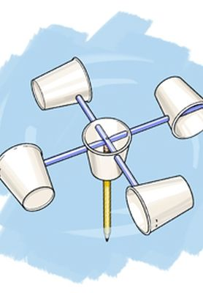

Slide 11
HUMIDITY SENSOR
Absolute humidity is the measure of the actual water vapor in the air.
Relative humidity is the ratio of the absolute humidity to the theoretical maximum for a given temperature and pressure. It is expressed as a %. So, if the air holds half of what it could hold, the relative humidity is 50%
Humidity sensor can be found in the same smartphones earlier mentioned in temperature sensor part

Slide 12
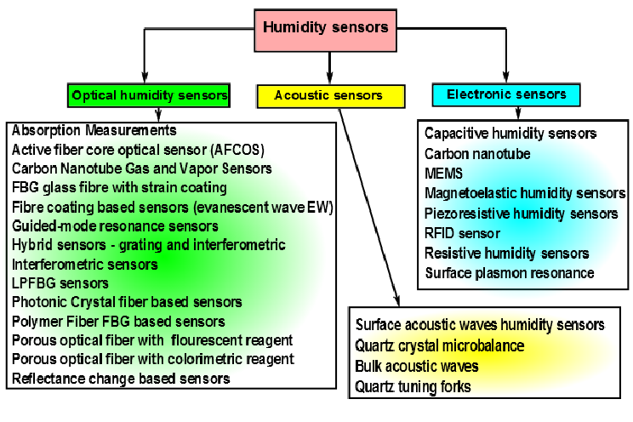

Slide 13
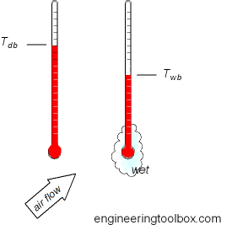
HUMIDITY SENSOR
Dry Bulb Wet Bulb Method:
A method which is very easy to implement is the dry bulb wet bulb method. For this, it is necessary to have to standard thermometers. By measuring the difference between them you can derive the relative humidity

Slide 14
LIGHT SENSOR
An easy version of a light sensor consists of a photo diode and a voltmeter or an ammeter
Measuring the current that comes out of the diode means measuring the strength of light that hits it
When hit with the maximal power of light, photo diodes let a small current from a couple micro amps flow
It is recommended to measure the voltage over a resistor, connected between the diode and ground. This would create a Vmax close to the supply voltage, which can be detected pretty easily

Slide 15
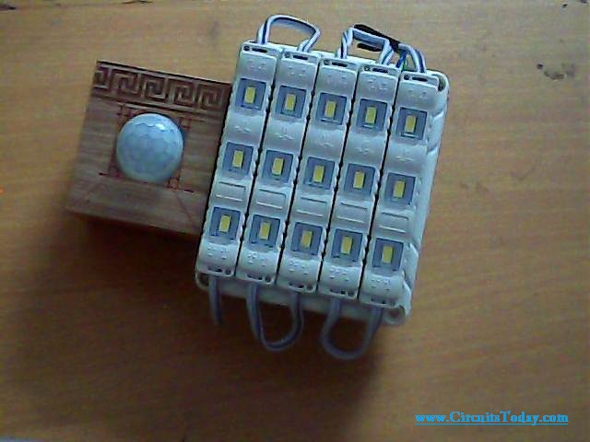
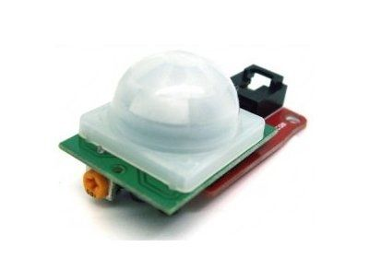

Slide 16
DETECTION OF WIND DIRECTION
A way to do it is with a couple of static pressure sensors
The first option is to put five pressure sensors around the station. Four sensors in the direction of the x and y axis and one neutral sensor on top. The four sensors would measure the static air pressure and dynamic pressure which is 0,5*density*velocity²
Second option is that it would be easier to build a device out of sheet metal which can be found in old computer cases
It includes making a flag that sits on a metal pole. The pole sits in the bearing of an CD drive and can rotate freely. On the rod is a piece of metal which touches a ring of metal while rotating. The ring of metal is separated in at least four parts of even size. The contacts are the equivalent of the cardinal direction. The wind pushes the flag which causes a rotation of the rod and a movement of the piece of metal

Slide 17
