Slide 1
PERFORMANCE SOLUTION Design of the whole system
MEASUREMENT AND PROCESS CONTROL SYSTEMS
DIYmeteo – Meteorological station made out of waste material
Leonarda Gajdić, Tomislav Krvavica, Johannes Pelz, Tom Schwarting, Kristijan Vešligaj

Slide 2
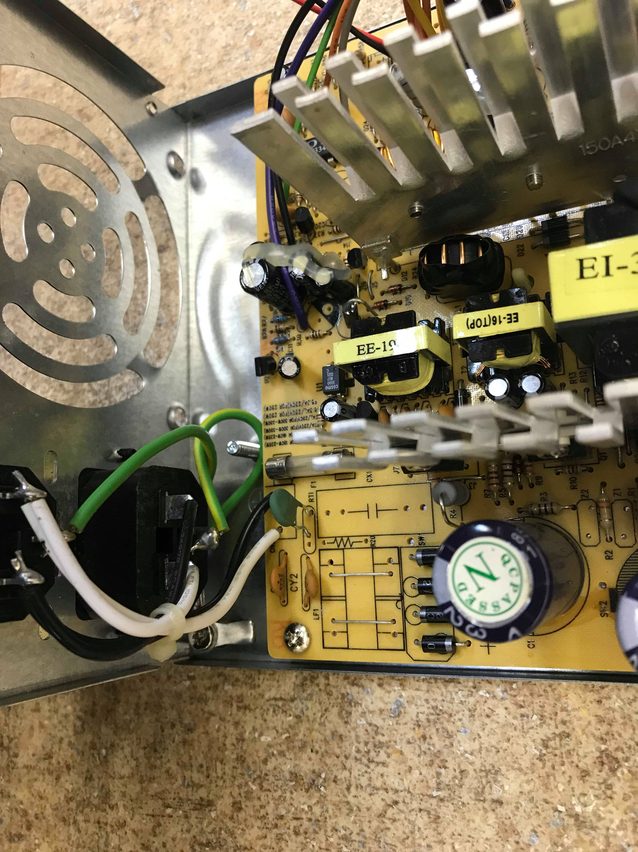
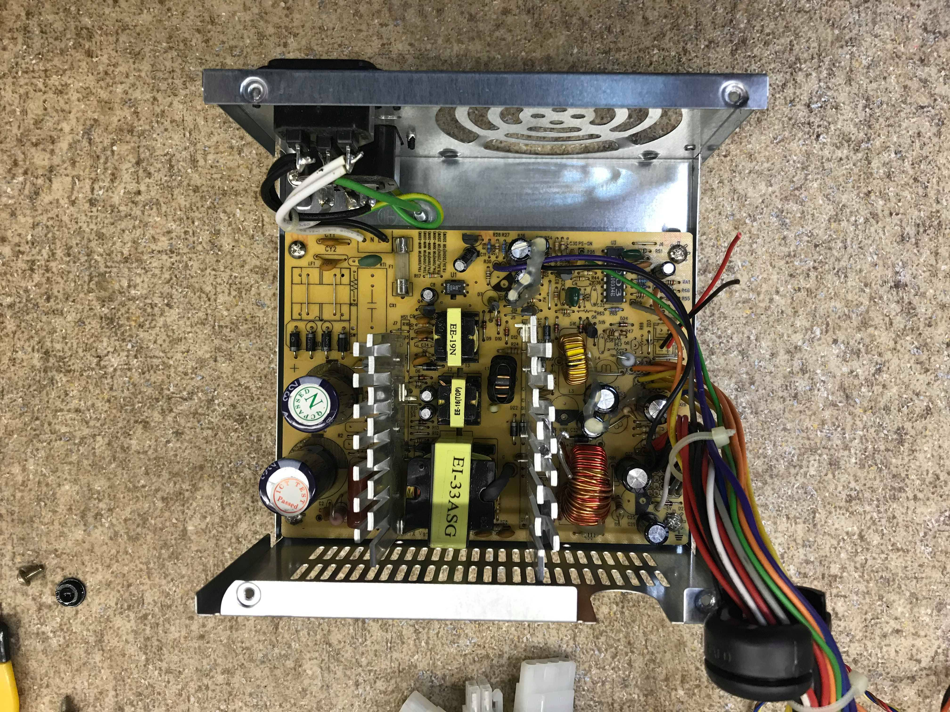
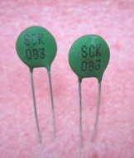
CHOSEN CONCEPT/MODEL/SOLUTION/TOOL
Temperature sensor
Thermistor SCK-083
Sensor from power supply

Slide 3
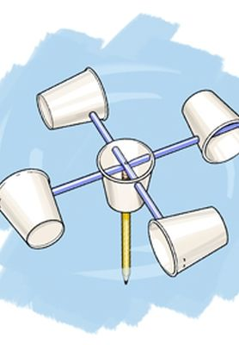
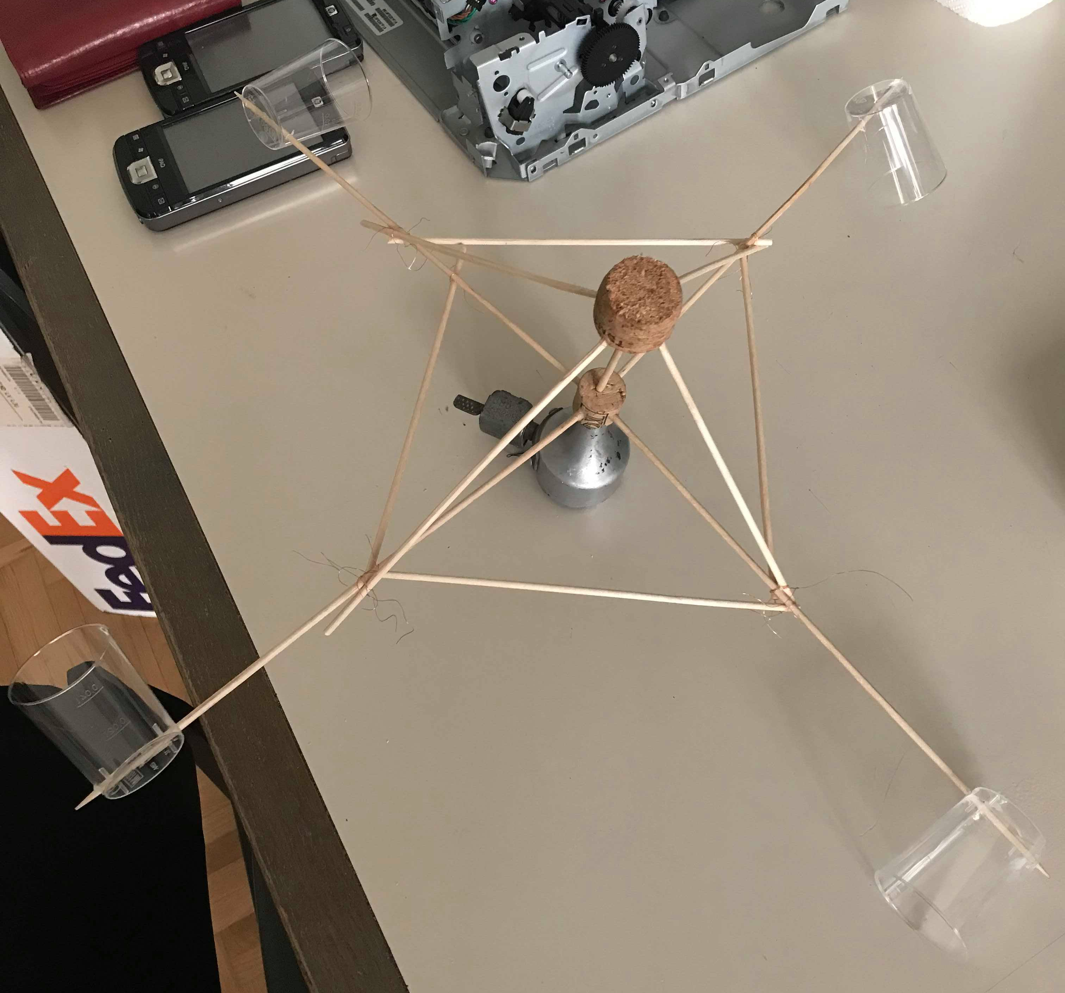
CHOSEN CONCEPT/MODEL/SOLUTION/TOOL
Anemometer - windspeed
First concept
Old dynamo from a bicycle, wooden sticks, plastic cups

Slide 4
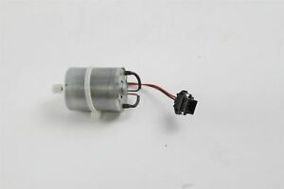
CHOSEN CONCEPT/MODEL/SOLUTION/TOOL
Anemometer - windspeed
Second concept
DC motor from an inkjet printer, bearings from power supply fan, sticks, cups

Slide 5
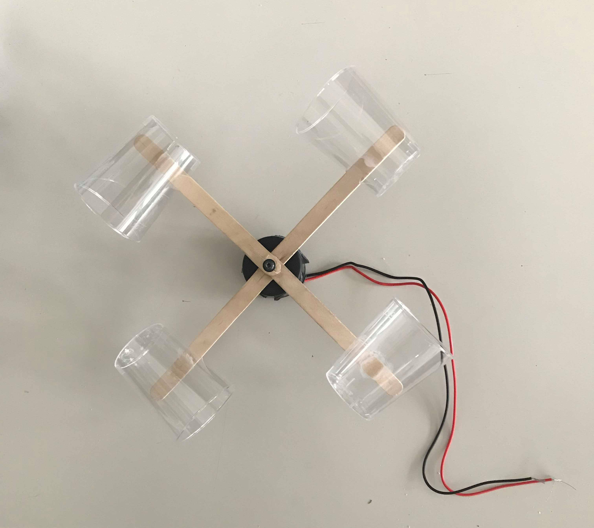
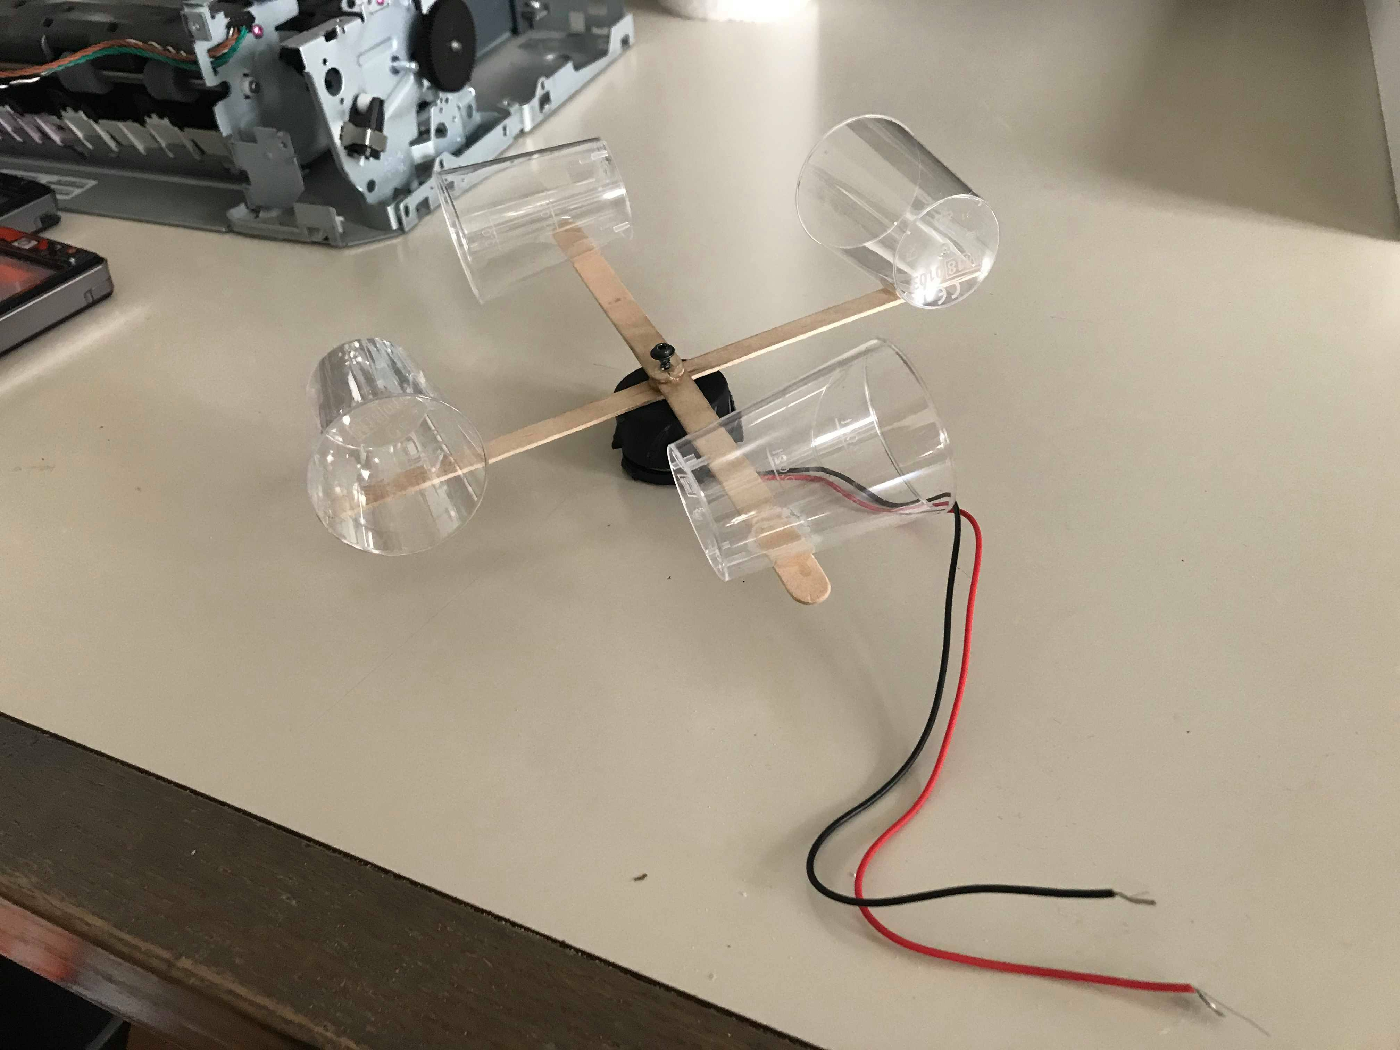
CHOSEN CONCEPT/MODEL/SOLUTION/TOOL
Anemometer - windspeed
Final concept
Power supply fan with chopped off blades, DC motor from an inkjet printer, sticks, cups

Slide 6
CHOSEN CONCEPT/MODEL/SOLUTION/TOOL
Wind direction
Photodiodes with light emitters used from computer mouse
First concept
Spiral like piece of plastic
Radius increases constantly
Wind flag covers a variable number of photo diodes
Number of diodes covered indicates the wind direction
Final concept
A variable number of diodes formed in circle
Position of diode covered with wind flag indicates the wind direction

Slide 7
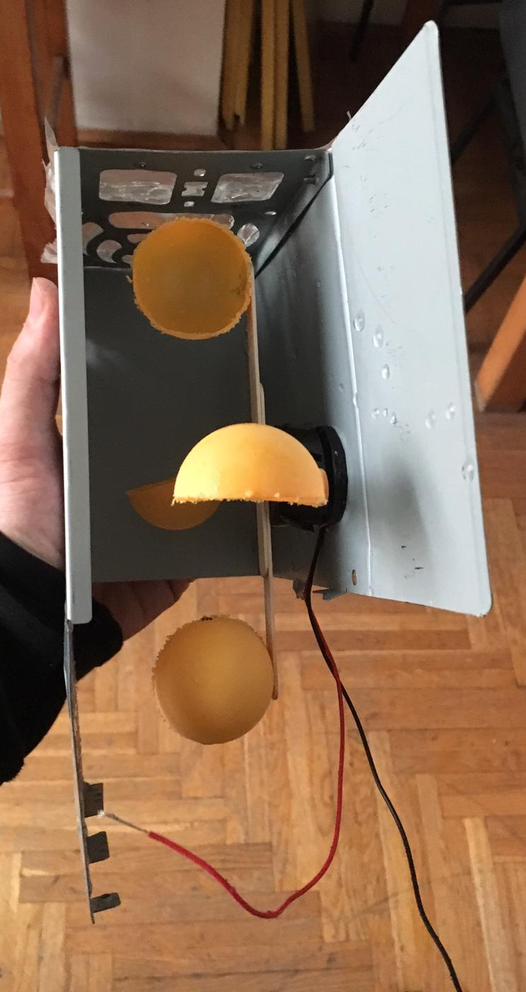
CHOSEN CONCEPT/MODEL/SOLUTION/TOOL
Rain sensor
Concept of a water wheel mill
One half of a ping-pong ball with a little
hole at the bottom
Spinning speed!

Slide 8
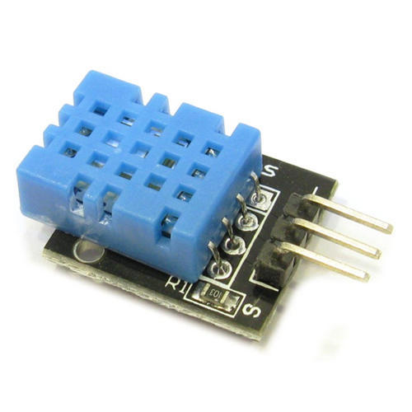
CHOSEN CONCEPT/MODEL/SOLUTION/TOOL
Temperature & humidity sensor
Bought component – DHT11
Easy to implement
Already existing library
If using this there is no need for creating
temperature sensor ourselves

Slide 9
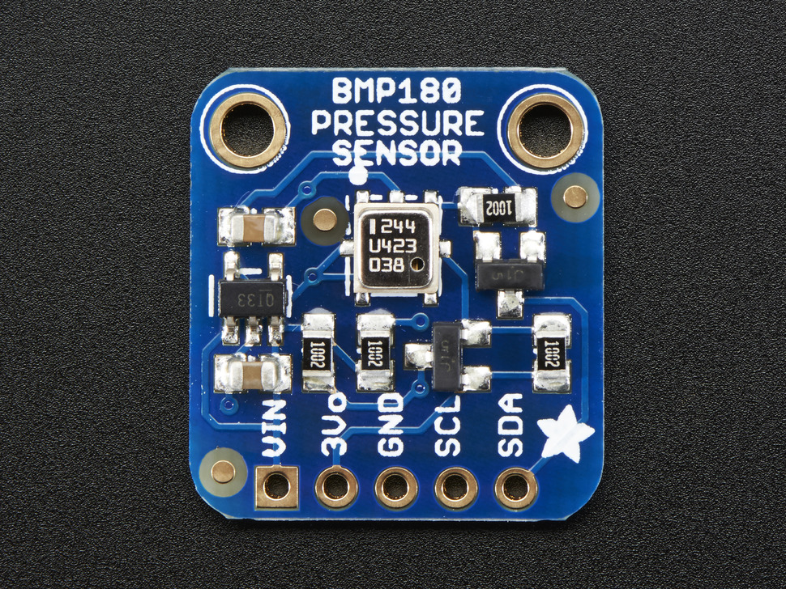
CHOSEN CONCEPT/MODEL/SOLUTION/TOOL
Air pressure sensor
Bought component – BMP180
Already existing library
Bonus assingment?

Slide 10
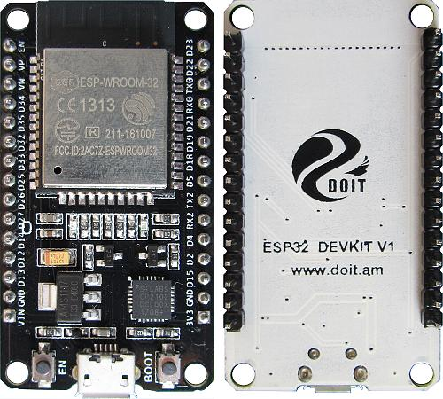
CHOSEN CONCEPT/MODEL/SOLUTION/TOOL
Data representation
Web server running on ESP32
ESP32
32-bit processor 160-240 MHz
WiFi chip on board
12 bit SAR ADC, 9 channels available
2x 8-bit DACs
I2S, I2C, UART, PWM

Slide 11
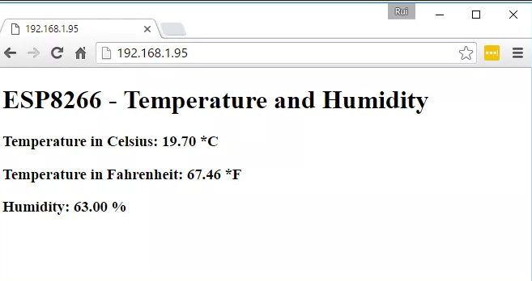
CHOSEN CONCEPT/MODEL/SOLUTION/TOOL
Web server
Using WiFi library
Parsing HTML code via serial (limits functionality)
DIY manual, students would need to enter: SSID and PW, and upload code to ESP
Designing web page left as bonus task

