Slide 1
FIRST USER INTERVIEW
MEASUREMENT AND PROCESS CONTROL SYSTEMS
DIYmeteo – Meteorological station made out of waste material
Leonarda Gajdić, Tomislav Krvavica, Johannes Pelz, Tom Schwarting, Kristijan Vešligaj

Slide 2
About the users
The users are middle school and high school students
Interview was made with doc. dr. sc. Predrag Pale who represented the students

Slide 3
User requirements
Tutorial that is easy to understand so they can do the project completely themselves
Maximal usability of waste material – the more reusable component the better
Finished product that can be easily made
Care about the sustainable development

Slide 4
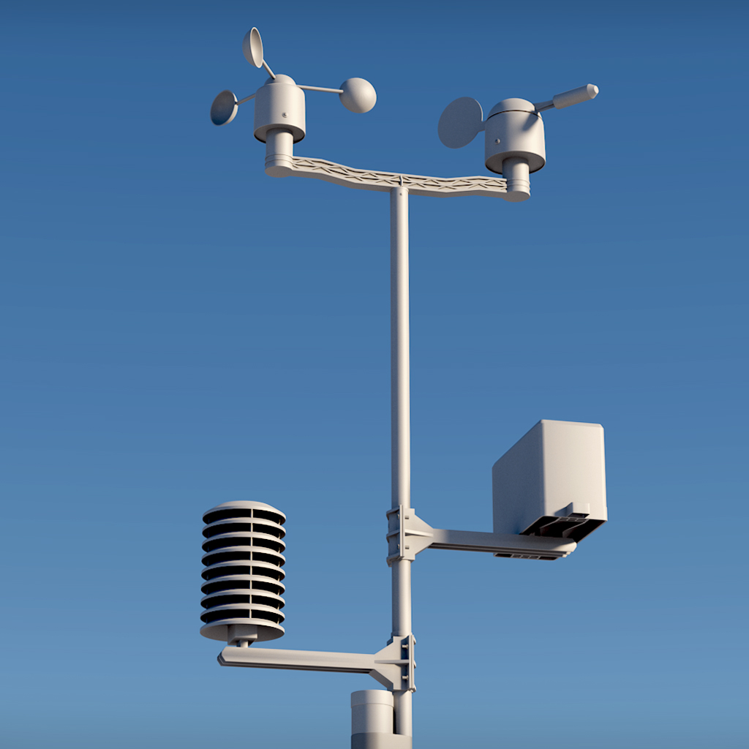
Measured parameters
Temperature
Pressure
Air density
Sunlight
UV index
Windspeed
Humidity

Slide 5
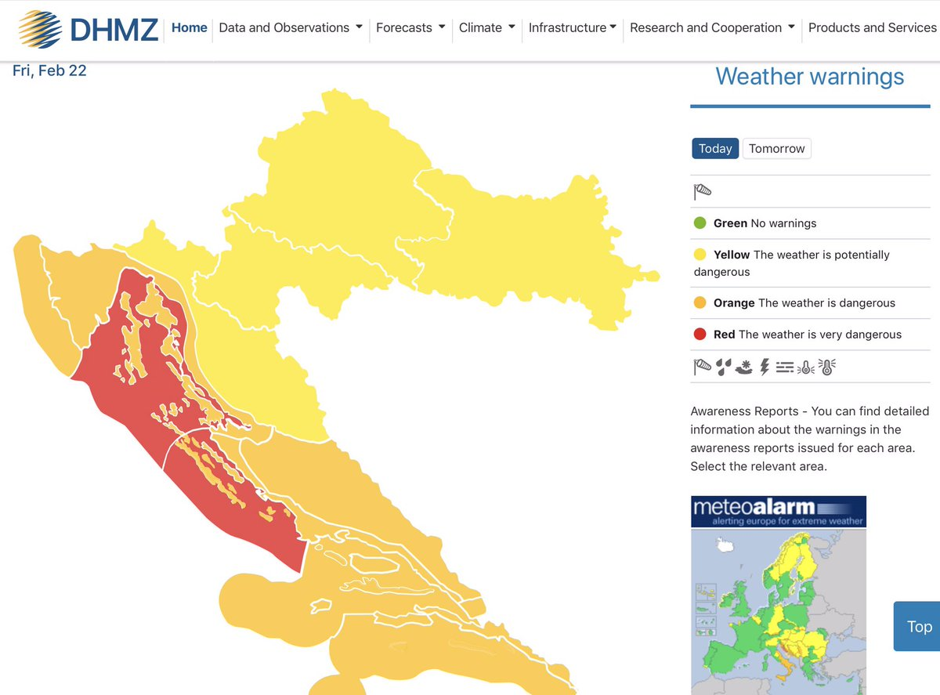
Network stations
Državni hidrometeorološki zavod
Personal Weather Station Network
Open Weather Map
The Weather Network

Slide 6
Airvisual
Needs to have access to electrical outlet and a Wi-Fi connection
Location needs to be sheltered from weather conditions such as direct sunlight, rain and wind
Location needs to be away from localized pollution sources such as BBQ, traffic or cigarette smoke

Slide 7
OpetWeatherMap
It works via special API key that you acquire after registration
After acquiring API key you can post your data vie HTTP POST requests
You need to enter parameters – latitude, longitude and altitude
Station needs to have Internet access
https://openweathermap.org/stations

Slide 8
Other networks
Weather Underground – not available in Croatia
Acurite – not available in Europe
Ambient Weather – only sells stations
Windfinder – does not have an option to join to the network

Slide 9
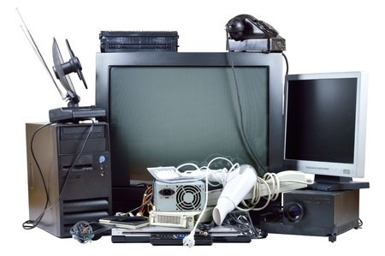
Waste material
Entertainment device electronics
Mobile devices
Computers
Television sets
Refrigerators
Any electronic product that is discarded

Slide 10
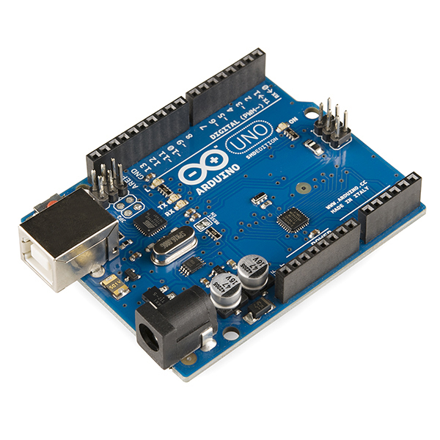
Controller platform
Arduino
ESP8266

